Slide 1
Computer Networks
CS 430

Slide 2
Objectives
Get familiar with terminology
Use the Internet as example
Edge
Core
Review protocol layered model
Identify networking problems
Performance
Security

Slide 3
Basic Terms: Matching
Fiber, copper, radio
HTTP
Host
NAT
Router
Service
Skype
TCP
Transmission rate
UDP
3-way handshake
Application layer
Bandwidth
Best-effort delivery
Communication link
End system
Internet Protocol
Private address
VoIP
Web

Slide 4
Basic Terms: Matching
Fiber, copper, radio
HTTP
Host
NAT
Router
Service
Skype
TCP
Transmission rate
UDP
Communication link
Web
End system
Private address
Internet Protocol
Application layer
VoIP
3-way handshake
Bandwidth
Best-effort delivery

Slide 5
Services
Web
HTTP
VoIP
SIP
H.323
Email
POP3
IMAP
SMTP
Host configuration
DHCP
Name resolution
DNS
Time synchronization
NTP
Simple file transfer
TFTP

Slide 6
Protocols
Define format, order of messages sent and received among network entities, and actions taken on message transmission or receipt
Defined in RFC (Request for Comments)

Slide 7
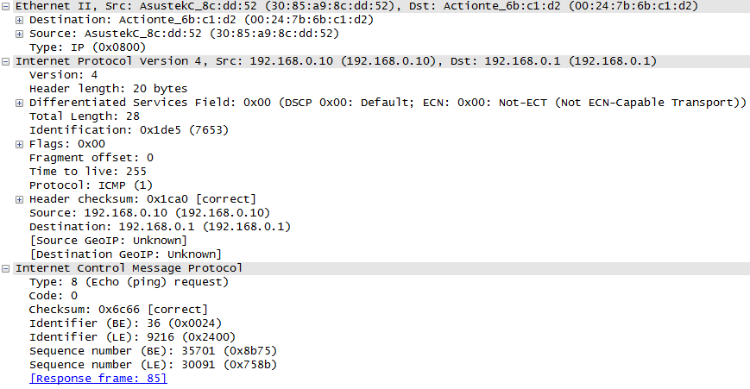
Protocol Encapsulation

Slide 8
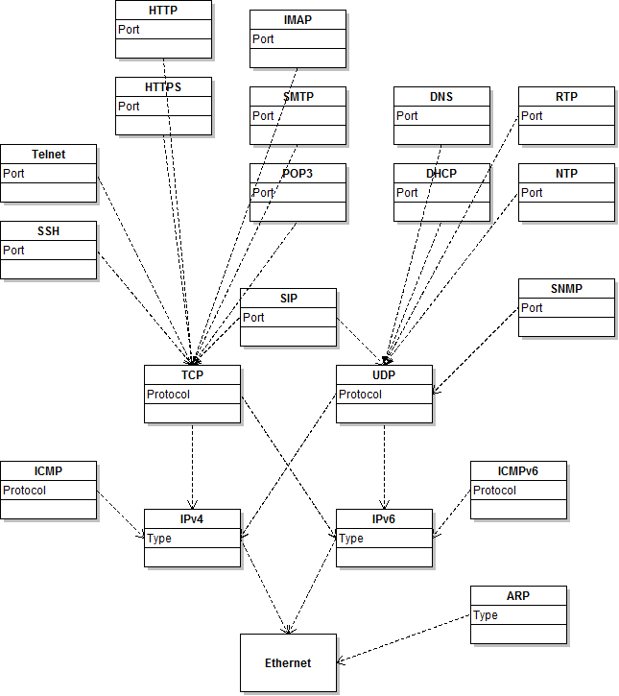
TCP/IP Stack
Application
Transport
Internet
Link
(Physical)

Slide 9
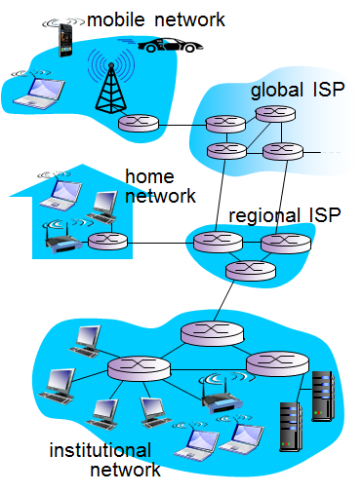
The Internet
Clients and Servers
Physical media
Wired
Wireless
Switches
Routers
ISPs

Slide 10
The Internet in 2016
Global traffic
1 ZB (1024 EB) by the end of 2016
Traffic sources
53% PC (2015)
Estimated to decrease to 29% by 2020
Video
Internet-to-TV
Surveillance
Virtual reality
Gaming
Notes:
http://www.excelacom.com/resources/blog/2016-update-what-happens-in-one-internet-minute
http://www.cisco.com/c/en/us/solutions/collateral/service-provider/visual-networking-index-vni/vni-hyperconnectivity-wp.html

Slide 11
The Internet in 2017

Slide 12
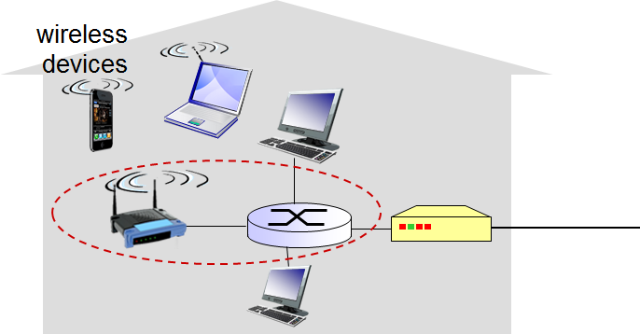
Connection
Bandwidth
Shared/dedicated
Wired/wireless
ADSL/Cable/Fiber
Ethernet
Cat5
Cat6
802.11
b/g/n/ac
3G/4G/LTE/WiMax

Slide 13
Packets
Application messages are broken into small chunks
Packets are forwarded across multiple links from source to destination
Store and forward
Delays
Packet loss
Queues and buffers
Packet switching
Routing

Slide 14
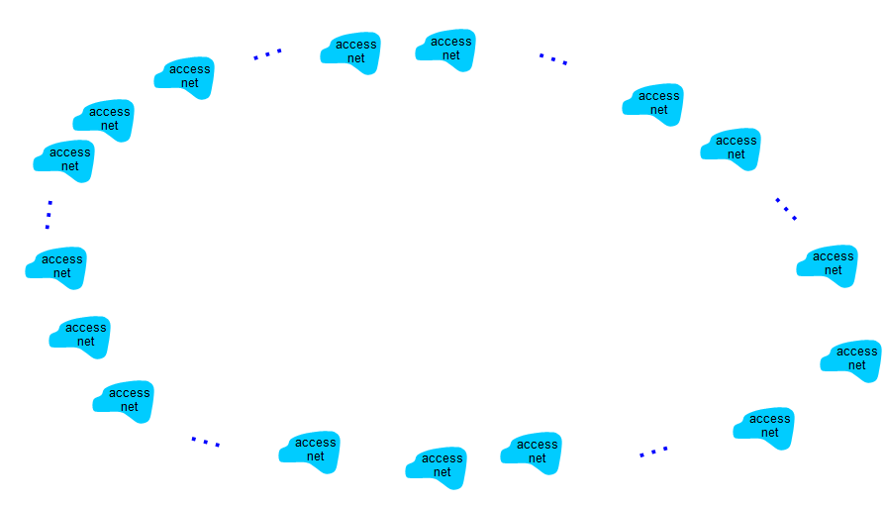
The Internet
Network of networks
ISP
Regional ISP
Internet exchange point
Content delivery networks

Slide 15
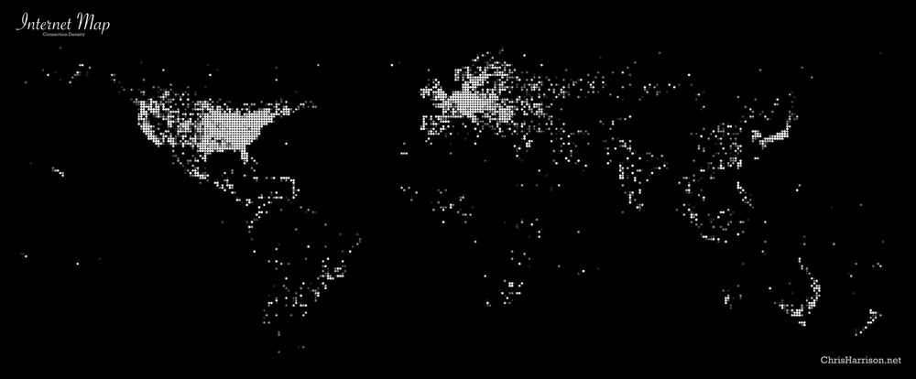
The Internet

Slide 16
The Internet
access
net
access
net
access
net
access
net
IXP
access
net
access
net
ISP A
…
…
Content provider network
access
net
IXP
ISP B
access
net
ISP C
access
net
access
net
access
net
regional net
access
net
…
access
net
access
net
…
access
net

Slide 17
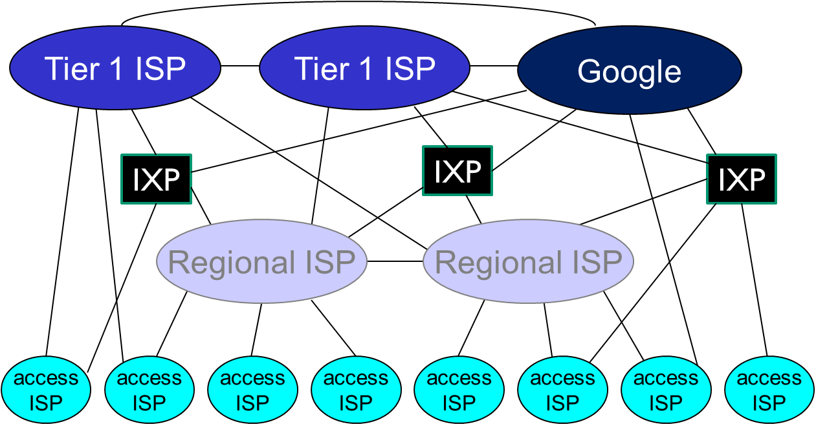
Internet Structure

Slide 18

source
message
M
application
transport
network
link
physical
segment
H_{t}
M
H_{t}
datagram
H_{n}
H_{n}
H_{t}
M
frame
H_{l}
H_{n}
H_{t}
M
link
physical
switch
destination
H_{n}
H_{t}
M
network
link
physical
M
application
transport
network
link
physical
H_{l}
H_{n}
H_{t}
M
H_{n}
H_{t}
M
H_{t}
M
H_{n}
H_{t}
M
H_{l}
H_{n}
H_{t}
M
router

Slide 19
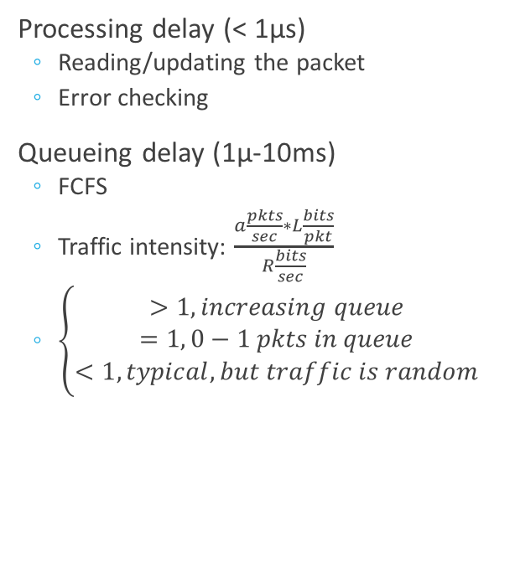
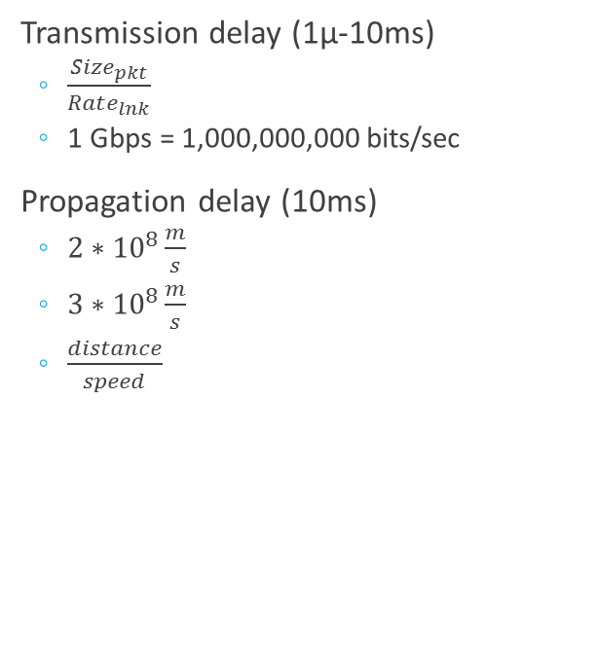
Quality of Service
Processing delay (< 1µs)
Reading/updating the packet
Error checking
Queueing delay (1µ-10ms)
FCFS
Traffic intensity: $\frac{a\frac{pkts}{sec}∗L\frac{bits}{pkt}}{R\frac{bits}{sec}}$
$\left\{\begin{aligned}>1, increasing queue \\ =1, 0−1 pkts in queue \\ <1,typical, but traffic is random\end{aligned}\right.$
Transmission delay (1µ-10ms)
$\frac{Size_{pkt}}{Rate_{lnk}}$
1 Gbps = 1,000,000,000 bits/sec
Propagation delay (10ms)
$2∗{10}^{8}\frac{m}{s}$
$3∗{10}^{8}\frac{m}{s}$
$\frac{distance}{speed}$

Slide 20
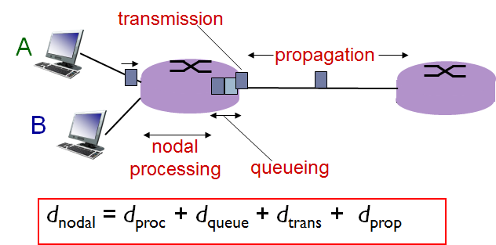
Four Sources of Packet Delay

Slide 21
Quality of Service
Packet loss
Buffer
Retransmission
Throughput
Rate at which bits transferred between sender/receiver

Slide 22
Exercise
Front row
Write “Hello” and a the destination “server” (A or B) on a piece of paper
Write a random number between 1 and 5 on your note
Pass the note to the closest student in the 2nd row
2nd row
Subtract 1 from the number on the note
If the number becomes 0, discard the note
Pass the note to a student in the 3rd row closest to the destination “server”
3rd row
Subtract 1 from the number on the note
If the number becomes 0, discard the note
Pass the note to a student in the 4th row closest to the destination “server” or to the “server” themselves
4th row
Subtract 1 from the number on the note
If the number becomes 0, discard the note
Pass the note to a student in the 4th row closest to the destination “server” or to the “server” themselves
Server
Keep the note

Slide 23
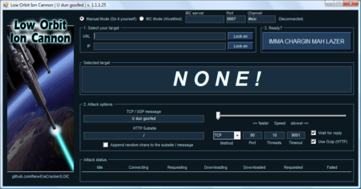
Network Security
Remote attacks
Malware
DDoS
LOIC
Packet sniffing
Man-in-the-middle
IP spoofing

Slide 24
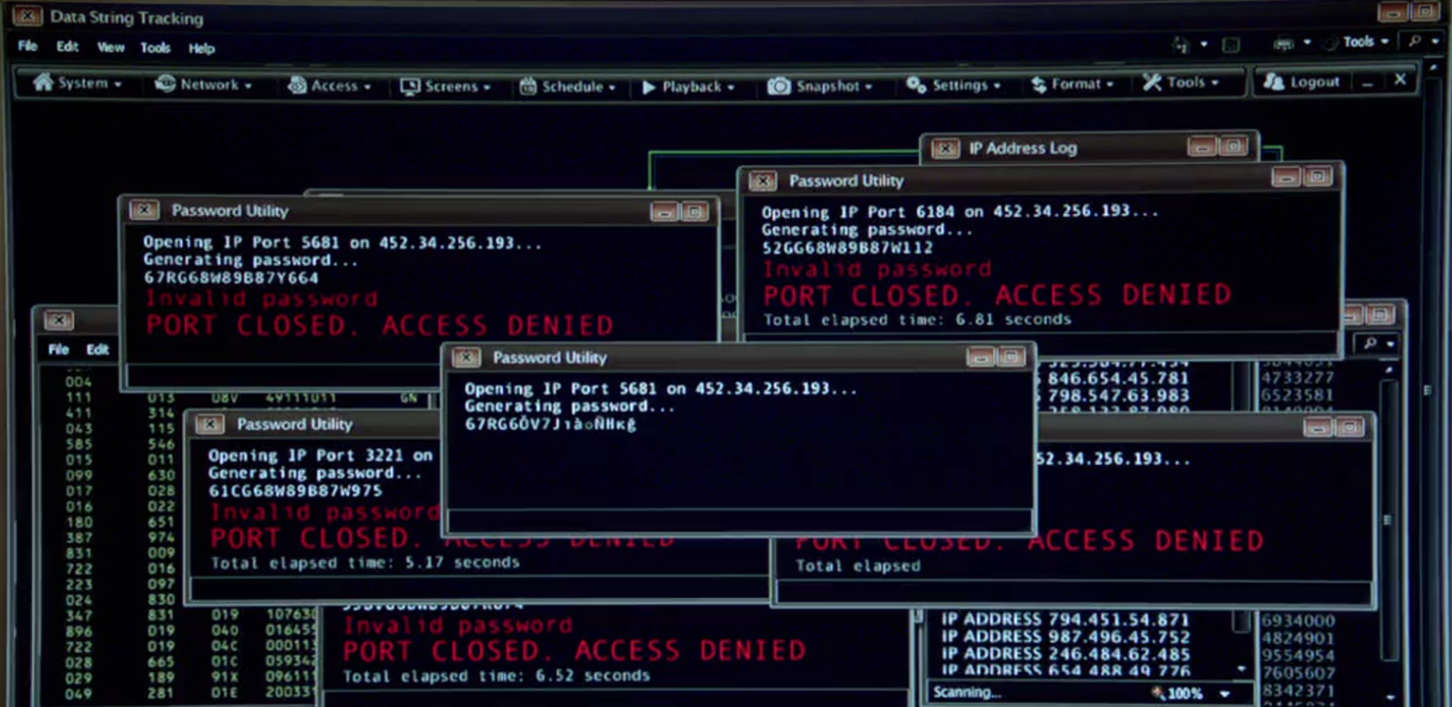
Network Security on TV

Slide 25
Top 10 Networking Problems
Packet loss
Latency
Window scaling issues
Response issues
Network design
Path issues
Malformed packets
Fragmentation
Timing issues
Infrastructure

Slide 26
Lecture Summary
What’s the Internet?
What’s a protocol?
Network edge; hosts, access net, physical media
Network core: packet/circuit switching, Internet structure
Performance: loss, delay, throughput
Security
Protocol layers, service models
History

Slide 27
Thank You!

